Slide 1


Compiled by Jaco Karstens
on the 9th of November 2022

Slide 2

Project Outline
Executive Summary
Introduction
Methodology
Results
Conclusion
Appendix

Slide 3
Executive Summary
Summary of methodologies
SpaceX advertises Falcon 9 rocket launches on its website with a cost of 62 million dollars compared to other providers that cost upward of 165 million dollars each.
The Big saving comes from the FIRST STAGE of their rocket launch, Spacex can reuse their FIRST STAGE of the rocket launch and thereby offer a huge discount compared to other providers.
So we want to be able to predict if the Falcon 9 FIRST STAGE will land successfully.
Following on with our first question, If we can predict if the FIRST STAGE will land, we can determine the COST of a rocket launch before launching a specific rocket.
So by making use of Data collection, Data Wrangling, Exploratory Data Analysis, Visual Data Analysis and finally perform predictive analysis using classification models to achieve a prediction and finally add a percentage of accuracy for the model we built to make the predictions.
This information can be useful if an alternate company wants to bid against SpaceX for a rocket launch or for a company planning to launch a rocket to place a satellite into orbit around our planet and want to add cost onto their project before launch with a success accuracy on top.

Slide 4
Executive Summary
Summary of all results and insights obtained
Final insights taken from the project has shown by using a algorithmic tree classifier algorithm we can predict with a accuracy of 88 % if a specific Falcon 9 rocket first stage will land and be able to reuse in a next rocket launch. We have also gained the following insights, there is a constant increase in the successful launch and landing of the Falcon 9 rocket first stage from 2013 to 2020, we can also conclude that therefore the success rate can only increase in the future.

Slide 5
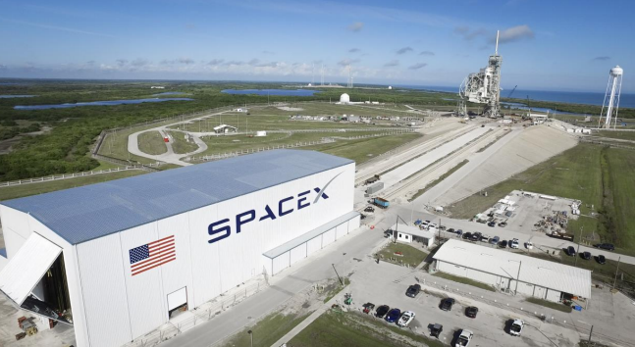
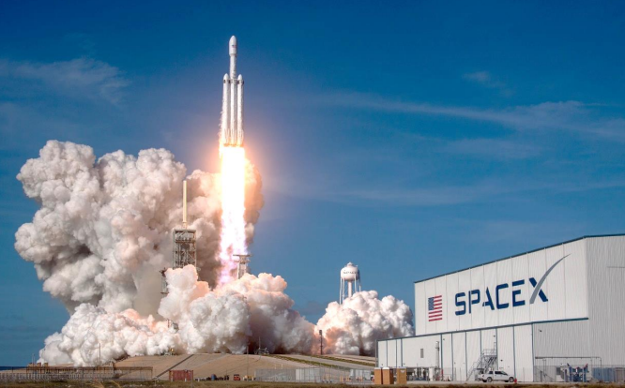
Introduction
Project background and context
Space Exploration Technologies Corp (SpaceX) is a space aviation company that manufactures and launches rockets and spacecraft. It handles cargo resupply missions to space stations. SpaceX offers a complete range of heavy, medium and light lift launch capabilities. The launch vehicle that is introduced by the company includes Falcon 9 and Falcon Heavy. It has launch sites at Cape Canaveral Air Force Station (CCAFS) in Florida and Vandenberg Air Force Base (VAFB) in California. The company also offers human spaceflight, rideshare program. The company offers products and portfolios under the brand names SpaceX, Falcon, Falcon Heavy, and Dragon. It uses a development facility in McGregor, Texas to tests engines and structures. SpaceX is headquartered in Hawthorne, California, the US.

Slide 6
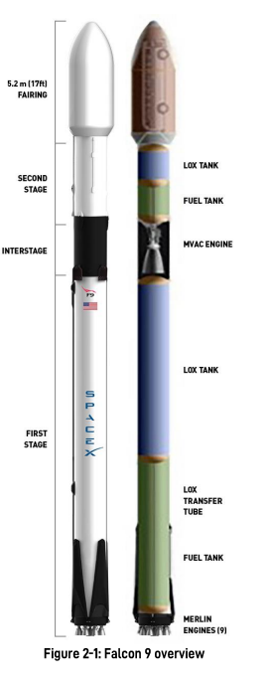
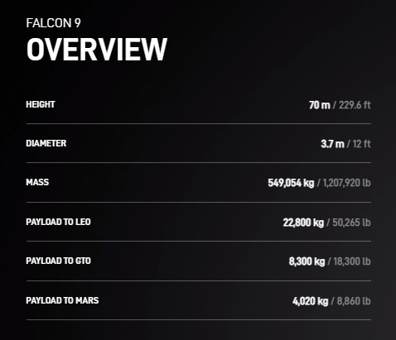
Introduction
We concentrated our research on their FALCON 9 rocket , the world's first Orbital Class Rocket capable of Reflight, please see visual on page as well as physical data
The Falcon 9 is a reusable, two-stage rocket designed and manufactured by SpaceX for the reliable and safe transport of people and payloads into Earth orbit and beyond. Falcon 9 is the world’s first orbital class reusable rocket. Reusability allows SpaceX to refly the most expensive parts of the rocket, which in turn drives down the cost of space access as stated by Spacex.

Slide 7
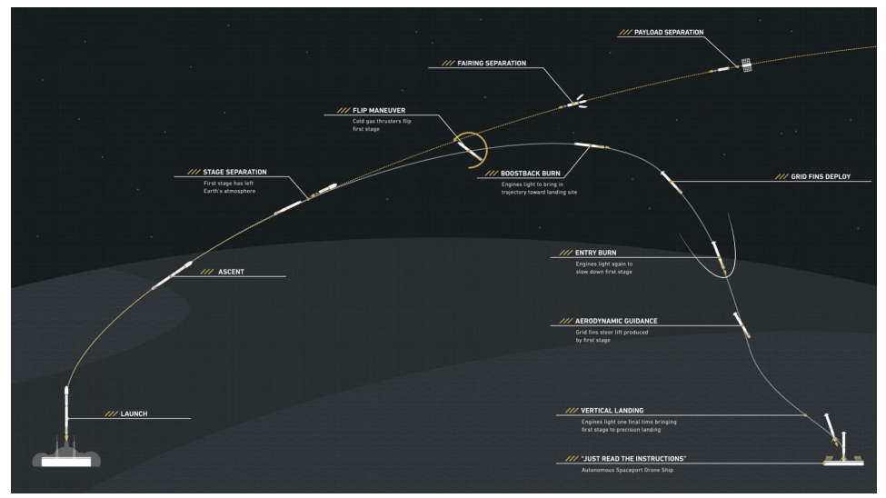
Introduction
So we wanted to be able to predict if the Falcon 9 Orbital Rocket FIRST STAGE will land successfully and which what success rating we will be able to predict an outcome of a SpaceX Falcon 9 Rocket launch, without taking natural factors acting onto the Rocket itself.
The Success rate ultimately is directly linked to the cost of a rocket launch, therefore ability to predict the cost is directly linked to a Successful landing of the First Stage of the Rocket.

Slide 8


Slide 9
Methodology
Data collection methodology:
Description of the data collection process and a description of the data collect for the project
Perform data wrangling
Description of the data processing process and processes used.
Perform exploratory data analysis (EDA) using visualization and SQL
Perform interactive visual analytics using Folium and Plotly Dash
Perform predictive analysis using classification models
Description of how the model was built, tuned and finally evaluating classification models
All files and notebooks used are made available in the following link:
https://github.com/AggroMonk/IBM_Data_Science.git

Slide 10
Data Collection
Description of how data sets were collected to be used in the project.
The Data we needed was historic data from Space Exploration Technologies Corp (SpaceX)
We collected the data and made sure the data was in the correct format from the SpaceX API.
We made a get request to the SpaceX API. Afterwards we did some basic data wrangling and formatting.
The data collection process used in the project.
We made a get request to the SpaceX API, Afterwards we did some basic data wrangling and formatting.
All files and notebooks used are made available in the following link:
https://github.com/AggroMonk/IBM_Data_Science.git

Slide 11
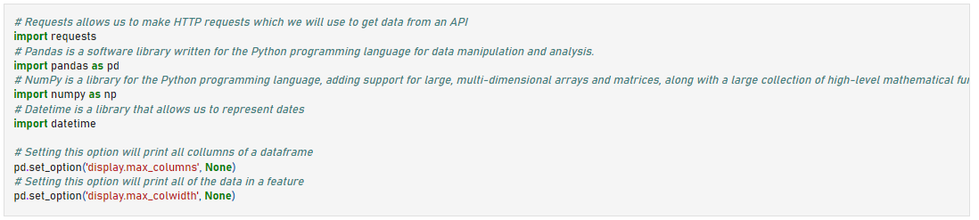
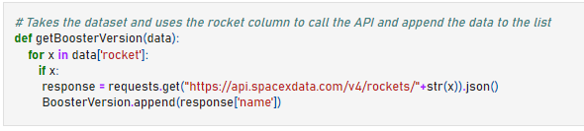
Data Collection – SpaceX API
Below are the some steps we implemented to import the Data:
We defined a series of helper functions that will help us use the API to extract information using identification numbers in the launch data.
From the rocket column we would like to learn the booster name.
step 1
step 2

Slide 12
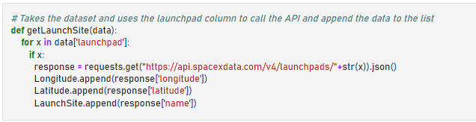
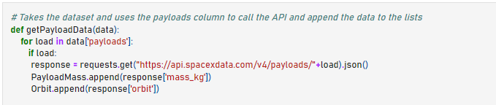
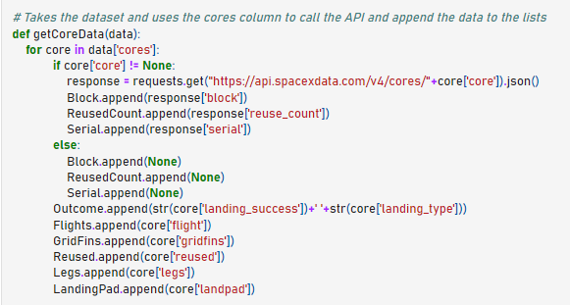
Data Collection – SpaceX API
3. From the launchpad we would like to know the name of the
launch site being used, the longitude, and the latitude.
4. From the payload we would like to learn the mass of the
payload and the orbit that it is going to.
5. From cores we would like to learn the outcome of the landing,
the type of the landing, number of flights with that core,
whether gryphons were used, whether the core is reused,
whether legs were used, the landing pad used, the block
of the core which is a number used to separate version of
cores, the number of times this specific core has been
reused, and the serial of the core.
step 3
step 4
step 5

Slide 13
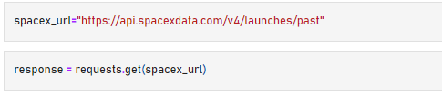
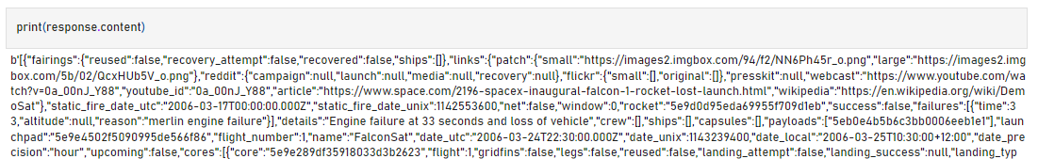
Data Collection – SpaceX API
6. Now let's start requesting rocket launch data from
SpaceX API with the following URL:
"https://api.spacexdata.com/v4/launches/past"
7. Next we print the response which contains massive information about SpaceX launches.
Next we discover some more relevant information for this project.
step 6

Slide 14
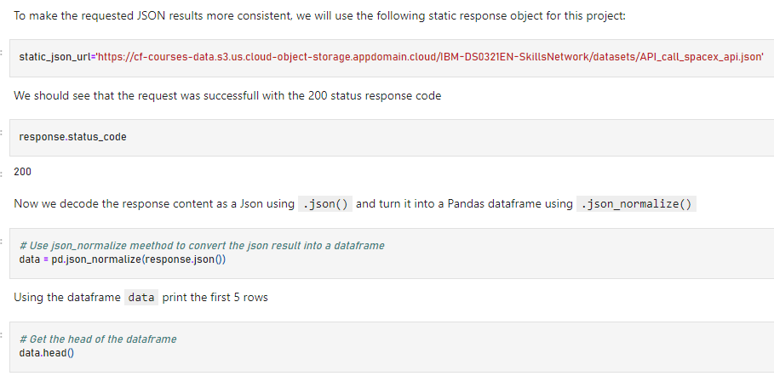
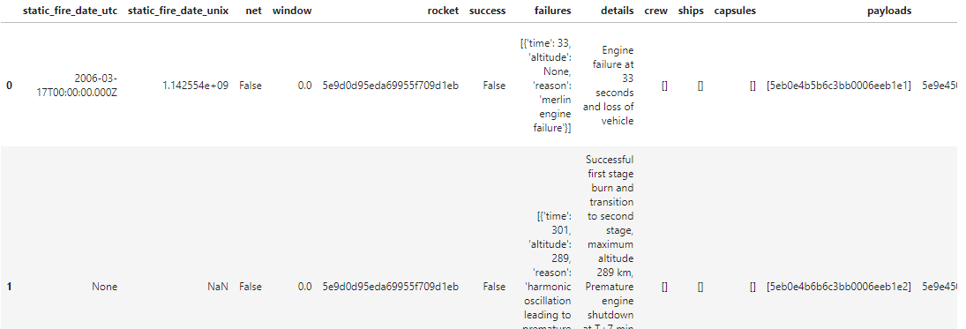
Data Collection – SpaceX API
7. We request and parse the SpaceX launch data using
the GET request and finally print the head of the
data sheet.
8. You will notice that a lot of the data are IDs.
For example the rocket column has no information
about the rocket just an identification number.
We will now use the API again to get information about
the launches using the IDs given for each launch.
Specifically we will be using columns rocket, payloads,
launchpad, and cores.
step 7
step 8

Slide 15
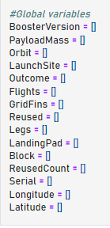
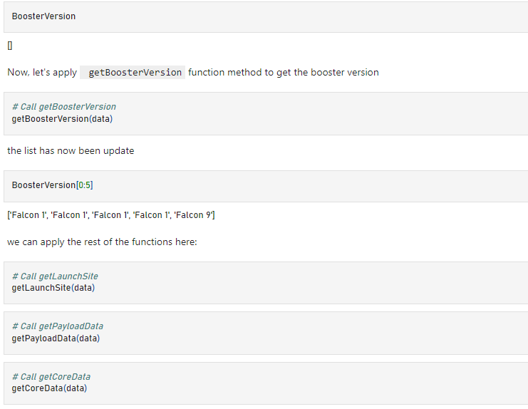
Data Collection – SpaceX API
9.
Next up from the rocket we would like to learn the booster name, from the payload we would like to learn the mass of the payload and the orbit that it is going to, from the launchpad we would like to know the name of the launch site being used, the longitude, and the latitude.and from cores we would like to learn the outcome of the landing, the type of the landing, number of flights with that core, whether griffins were used, whether the core is reused, whether legs were used, the landing pad used, the block of the core which is a number used to separate version of cores, the number of times this specific core has been reused, and the serial of the core.
The data from these requests will be stored in lists and will be used to create a new dataframe.
These functions will apply the outputs globally to the
above variables. Let's take a looks at Booster Version
variable. Before we apply getBoosterVersion the list is empty:
step 9
10.
Data List
step 10

Slide 16
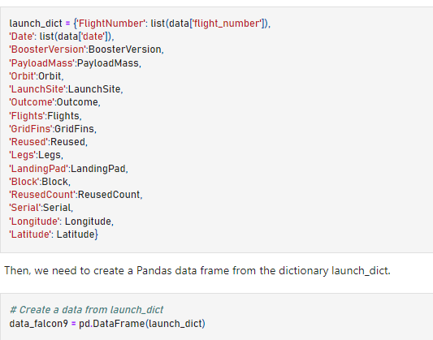
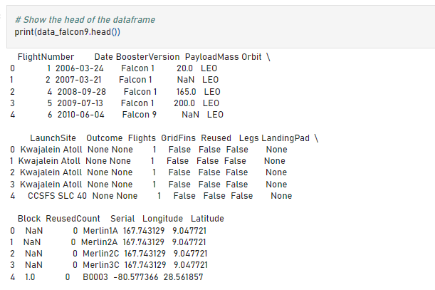
Data Collection – SpaceX API
11. We applied getBoosterVersion function method to get the booster version
and Finally we constructed our dataset using the data we have obtained. We
we combine the columns into a dictionary.
12. Then we create a Pandas dataframe from the dictionary launch_dict. and show
the summary of the dataframe.
Our pandas Dataframe
step 11

Slide 17
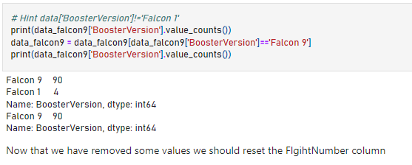
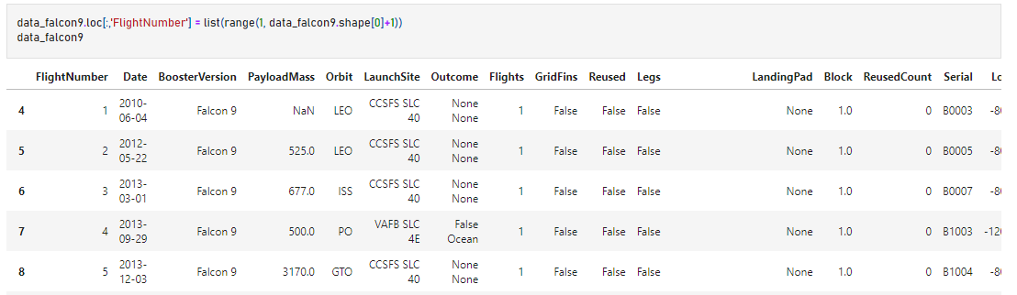
Data Collection – SpaceX API
13. Now that we have removed some values we should reset the
FlightNumber column
14. And Finally we can view the DataFrame.
step 13

Slide 18
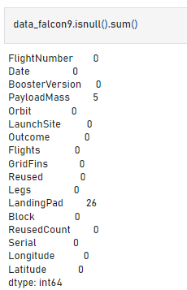
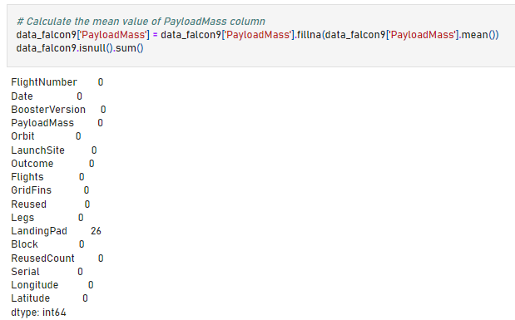
Data Collection – SpaceX API
15. We can see that some of the rows are missing values in our dataset. Before we can continue we must
deal with these missing values. The LandingPad column will retain None values to represent when landing
pads were not used.
16. Calculate below the mean for the PayloadMass using the .mean(). Then use the mean and the
.replace() function to replace np.nan values in the data with the mean you calculated. You should
see the number of missing values of the PayLoadMass change to zero. Now we should have no
missing values in our dataset except for in LandingPad.
step 15

Slide 19
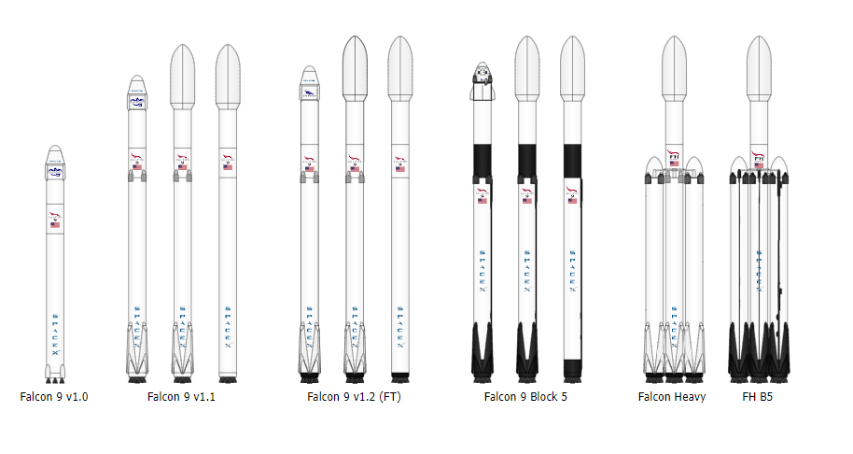
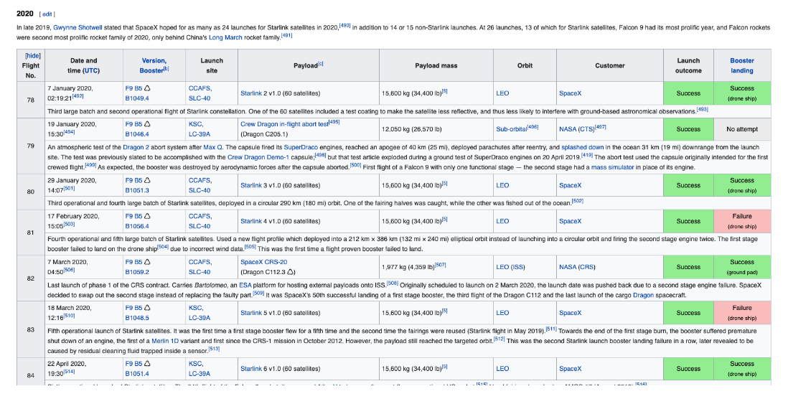
Data Collection - Scraping
We performed web scraping to collect Falcon 9 historical launch records from a Wikipedia page titled List of Falcon 9 and Falcon Heavy launches
https://en.wikipedia.org/wiki/List_of_Falcon\_9\_and_Falcon_Heavy_launches
More specifically, the launch records are stored in a HTML table shown above.
All files and notebooks used are made available in the following link:
https://github.com/AggroMonk/IBM_Data_Science.git

Slide 20
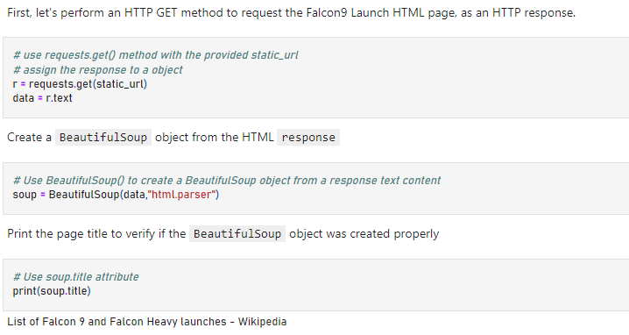
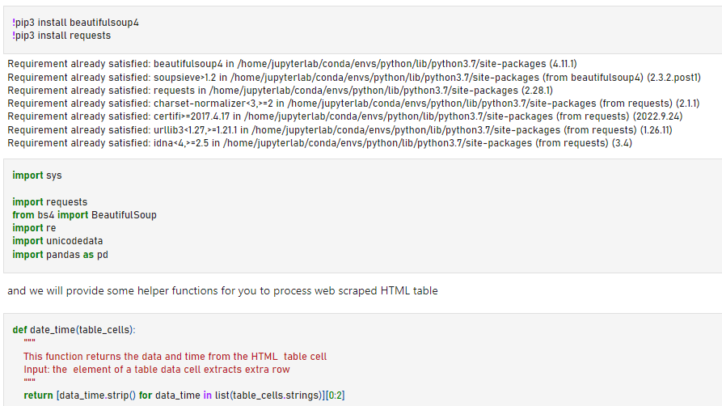
Data Collection - Scraping
So Firstly we web scraped the Falcon 9 launch records with BeautifulSoup: , extracting the Falcon 9 launch records HTML table from Wikipedia
We imported some required packages and helper functions for us to process web scraped HTML table and Request the Falcon 9 Launch Wiki page from its URL

Slide 21
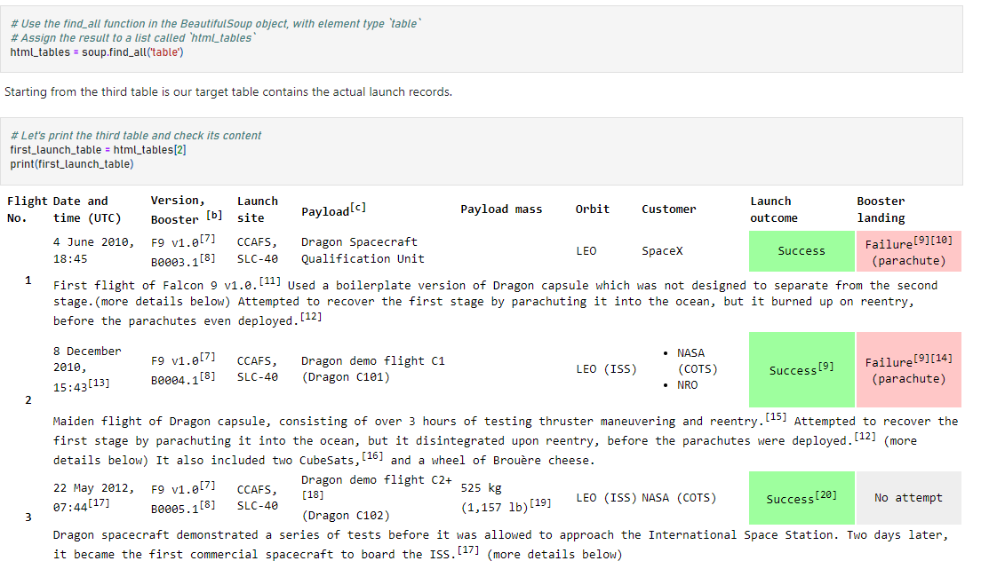
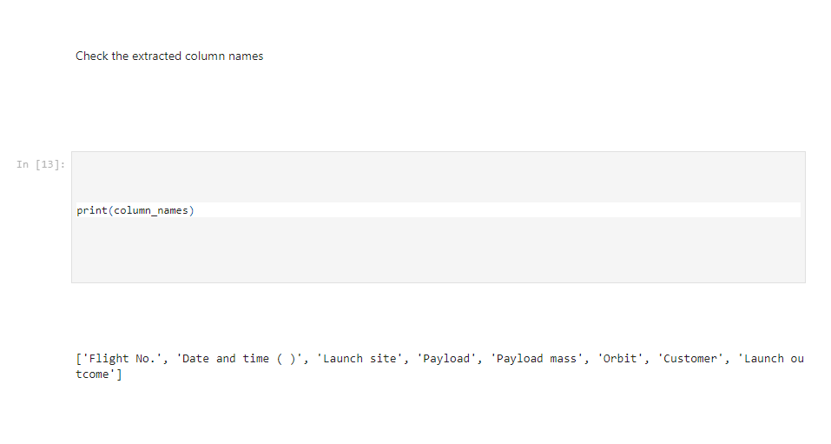
Data Collection - Scraping
Next, we collected all relevant column names from the HTML table header

Slide 22
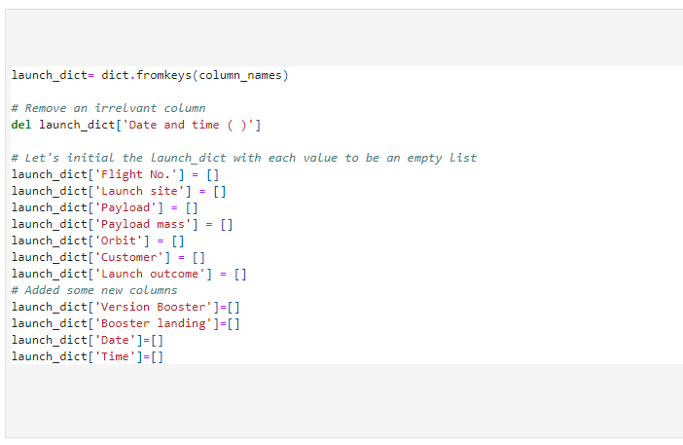
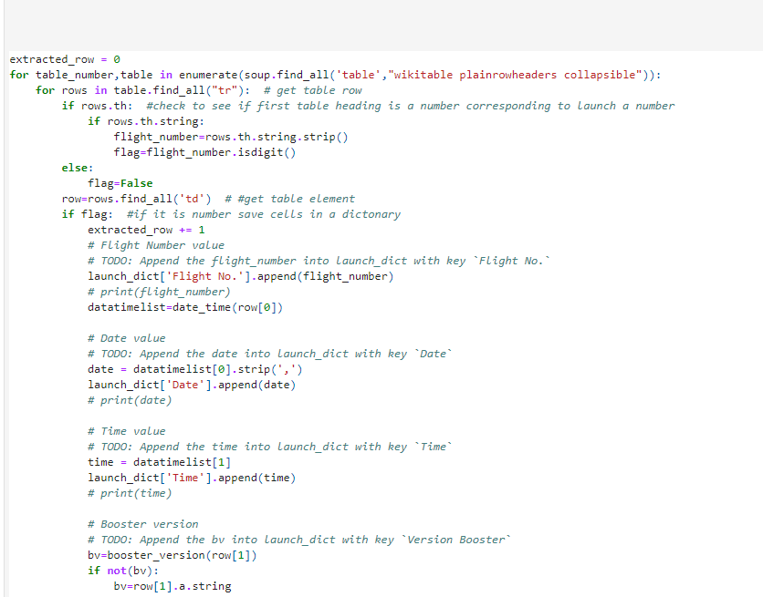
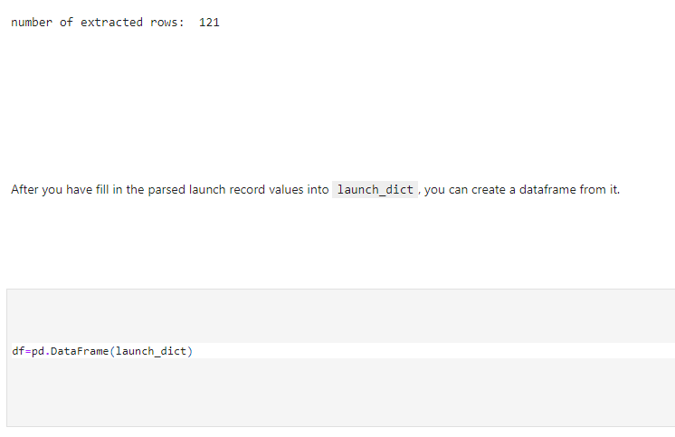
Data Collection - Scraping
Next, we Create a data frame by parsing the launch HTML tables, we created an empty dictionary with keys from the extracted column names in the previous task and then converted the dictionary into a Pandas dataframe
Pandas DataFrame

Slide 23
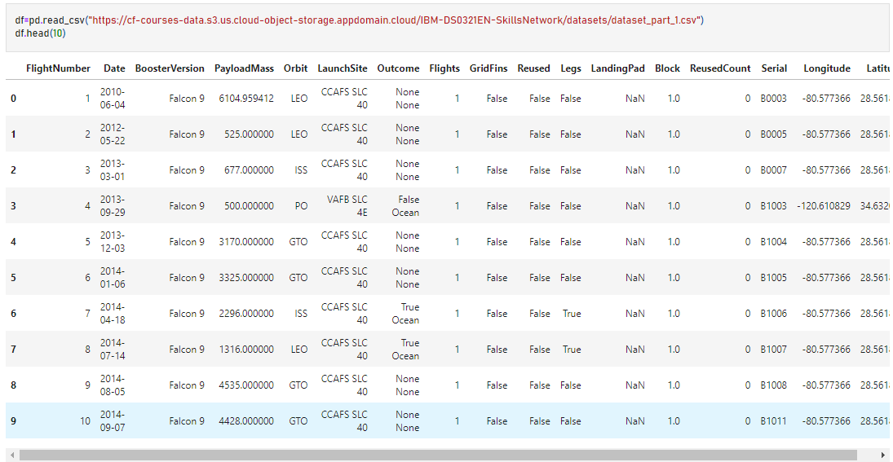
Data Wrangling
We performed some Exploratory Data Analysis (EDA) to find some patterns in the data and determine what would be the label for training supervised models.
In the data set, there are several different cases where the booster did not land successfully. Sometimes a landing was attempted but failed due to an accident; for example, True Ocean means the mission outcome was successfully landed to a specific region of the ocean while False Ocean means the mission outcome was unsuccessfully landed to a specific region of the ocean. True RTLS means the mission outcome was successfully landed to a ground pad False RTLS means the mission outcome was unsuccessfully landed to a ground pad.True ASDS means the mission outcome was successfully landed on a drone ship False ASDS means the mission outcome was unsuccessfully landed on a drone ship. We mainly converted those outcomes into Training Labels with 1 means the booster successfully landed 0 means it was unsuccessful.
All files and notebooks used are made available in the following link: https://github.com/AggroMonk/IBM_Data_Science.git

Slide 24
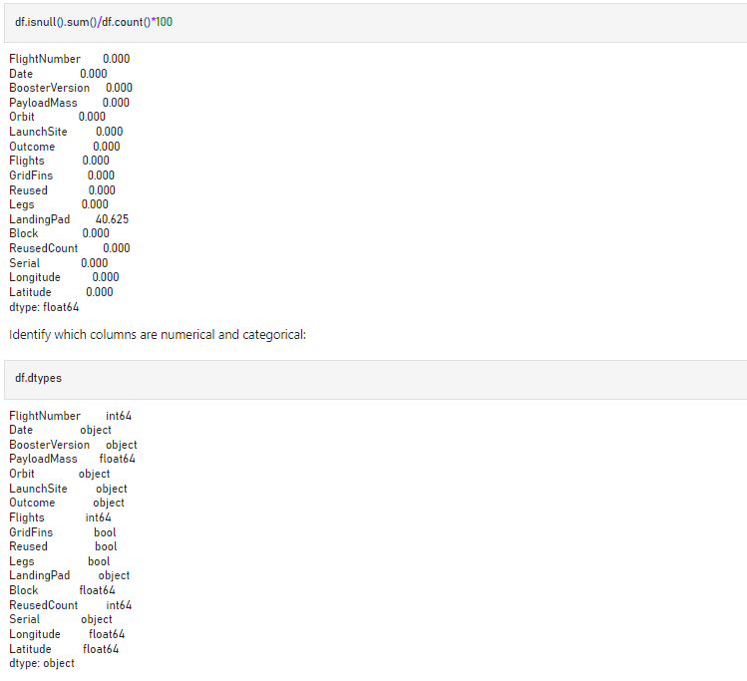
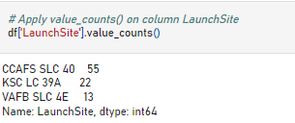
Data Wrangling
First we calculated the number of launches on each site. The data contained several Spacex launch facilities: Cape Canaveral Space Launch Complex 40 VAFB SLC 4E , Vandenberg Air Force Base Space Launch Complex 4E (SLC-4E), Kennedy Space Center Launch Complex 39A KSC LC 39A .The location of each Launch Is placed in the column LaunchSite. Each launch aims to an dedicated orbit, and please see the orbit types.

Slide 25
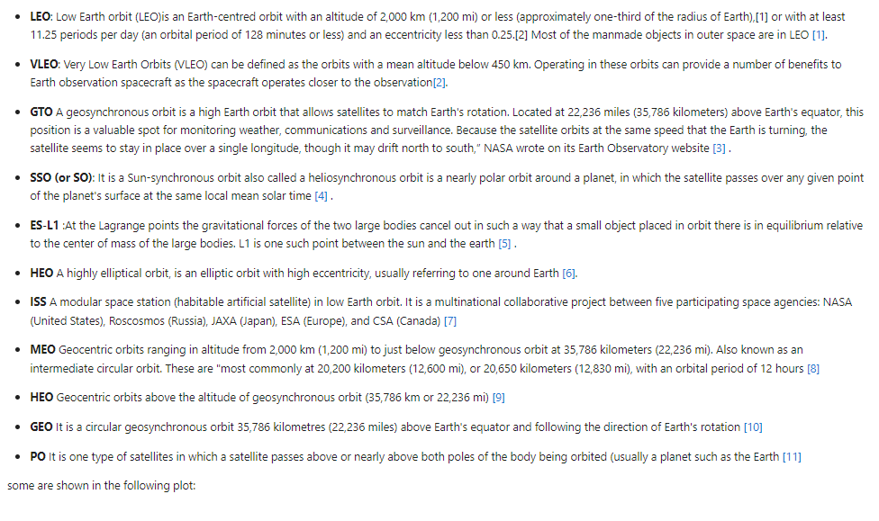
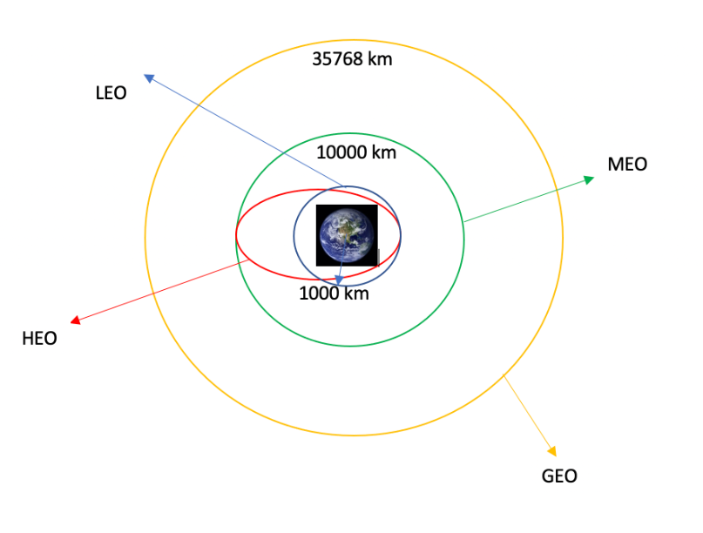
Data Wrangling
Each launch aims to an dedicated orbit, and please see the orbit types.

Slide 26
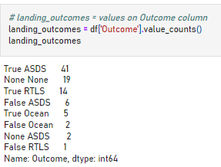
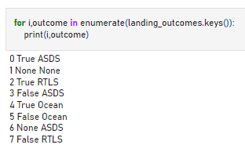
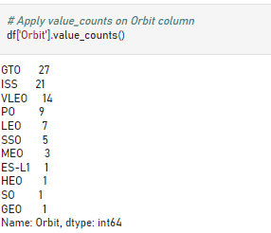
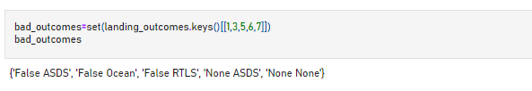
Data Wrangling
Firstly we calculated the number and occurrence of each orbit by using the method .value_counts() to determine the number and occurrence of each orbit in the column Orbit, then using the method .value_counts() on the column Outcome to determine the number of landing_outcomes.Then we assigned it to a variable landing_outcomes. Then we create a set of outcomes where the second stage did not land successfully:

Slide 27
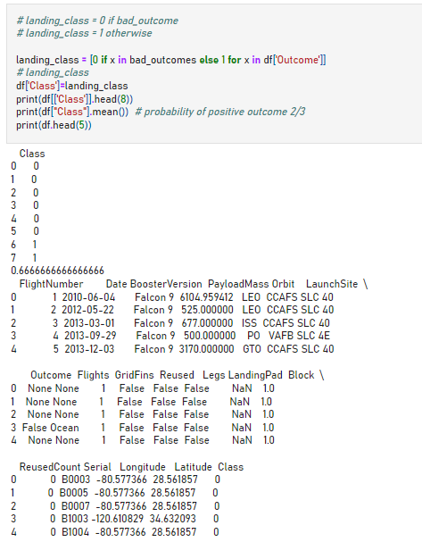
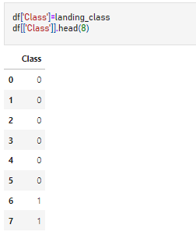
Data Wrangling
Next Step, using the Outcome, create a list where the element is zero if the corresponding row in Outcome is in the set bad_outcome; otherwise, it's one. Then assign it to the variable landing_class: This variable will represent the classification variable that represents the outcome of each launch. If the value is zero, the first stage did not land successfully; one means the first stage landed Successfully.

Slide 28
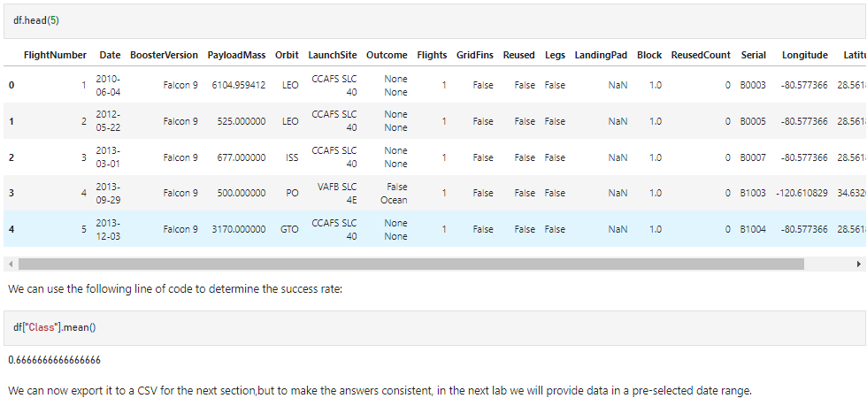
Data Wrangling
Then finally using the .mean() function to determine the success rate:
Which in our case study is 0.66 %

Slide 29
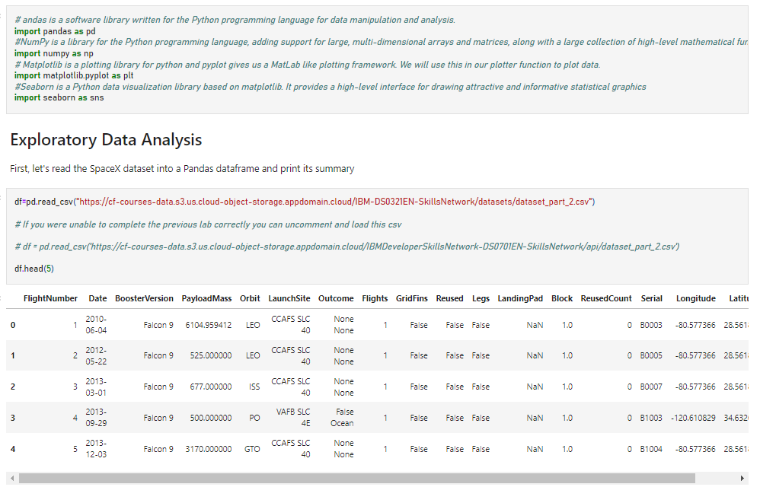
EDA with Data Visualization
We will predict if the Falcon 9 first stage will land successfully by using exploratory Data Analysis and Feature Engineering using Pandas and Matplotlib, Firstly we will import required python libraries and download our dataset.
All files and notebooks used are made available in the following link: https://github.com/AggroMonk/IBM_Data_Science.git

Slide 30
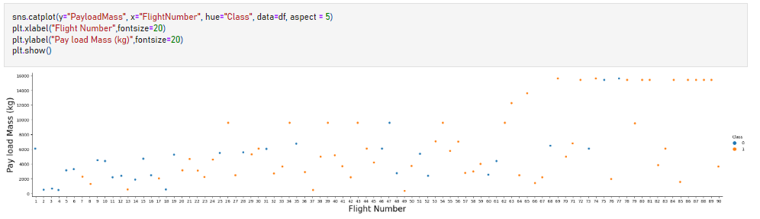
EDA with Data Visualization
To see how the FlightNumber (indicating the continuous launch attempts.) and Payload variables would affect the launch outcome. We plot out the FlightNumber vs. PayloadMassand overlay the outcome of the launch. We see that as the flight number increases, the first stage is more likely to land successfully. The payload mass is also important; it seems the more massive the payload, the less likely the first stage will return.
We see that different launch sites have different success rates. CCAFS LC-40, has a success rate of 60 %, while KSC LC-39A and VAFB SLC 4E has a success rate of 77%.
After the visualization process we move to the Feature engineering.

Slide 31
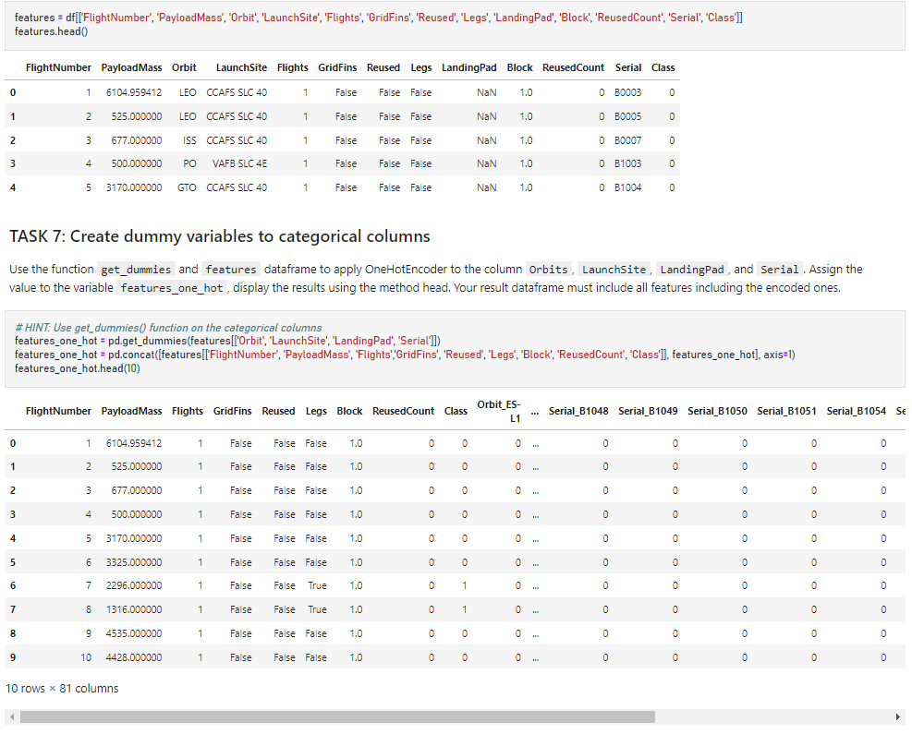
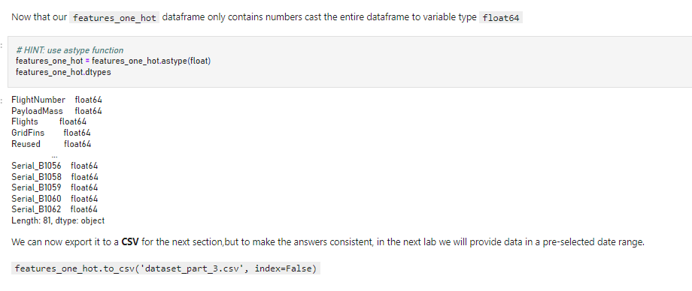
EDA with Data Visualization
We obtained some preliminary insights about how each important variable would affect the success rate, we then selected the features that will be used in success prediction in the future project. Fastly we casted all numeric columns to float64.

Slide 32
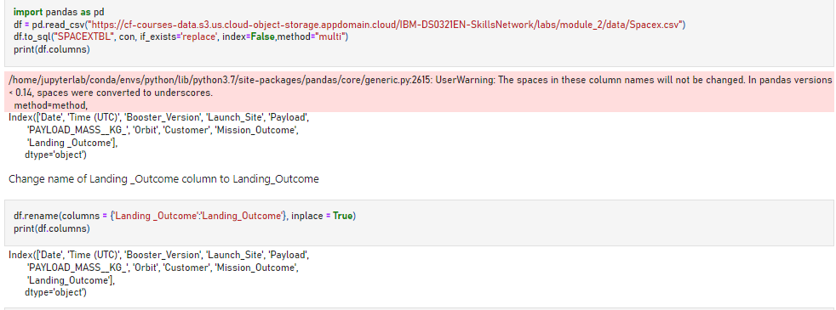
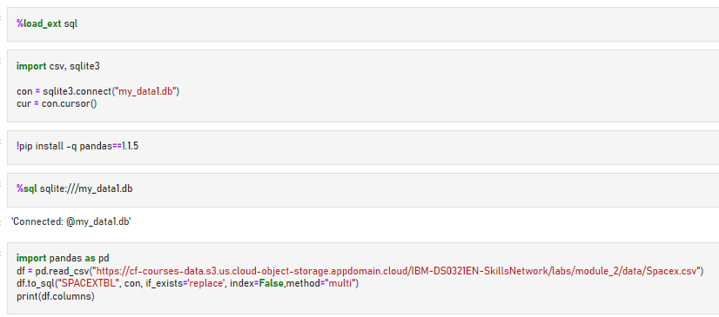
EDA with SQL
Firstly we loaded the SQL extension and establish a connection with the database, whereafter we wrote and executed SQL queries to solve the required tasks.
All files and notebooks used are made available in the following link: https://github.com/AggroMonk/IBM_Data_Science.git

Slide 33
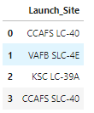

EDA with SQL
Finally we wrote and executed the following SQL queries to solve the following tasks:
Display the names of the unique launch sites in the space mission
Display 5 records where launch sites begin with the string 'CCA'

Slide 34
EDA with SQL
Finally we wrote and executed the SQL queries to solve the following tasks:
Display the total payload mass carried by boosters launched by NASA (CRS)?
The total mass transported by NASA (CRS) is 619967 kg
Display average payload mass carried by booster version F9 v1.1? '2928.4 kg'
List the date when the first successful landing outcome in ground pad was achieved? '22-12-2015'
List the names of the boosters which have success in drone ship and have payload mass greater than 4000 but less than 6000?
Booster versions with the description ['F9 FT B1022', 'F9 FT B1026', 'F9 FT B1021.2', 'F9 FT B1031.2'] have masses between 4000 and 6000 and succeeded in landing by drone ship
List the total number of successful and failure mission outcomes
There were 100 successful and 1 unsuccessful mission

Slide 35



EDA with SQL
Finally we wrote and executed the SQL queries to solve the following tasks:
List the names of the booster_versions which have carried the maximum payload mass. Use a subquery?
List the records which will display the month names, failure landing_outcomes in drone ship ,booster versions, launch_site for the months in year 2015?
Rank the count of successful landing_outcomes between the date 04-06-2010 and 20-03-2017 in descending order.?

Slide 36

Build an Interactive Map with Folium
The launch success rate may depend on many factors such as payload mass, orbit type, and so on. It may also depend on the location and proximities of a launch site, i.e., the initial position of rocket trajectories. Finding an optimal location for building a launch site certainly involves many factors and hopefully we could discover some of the factors by analyzing the existing launch site locations.
In the previous exploratory data analysis, we have visualized the SpaceX launch dataset using matplotlib and seaborn and discovered some preliminary correlations between the launch site and success rates. In this lab, you will be performing more interactive visual analytics using Folium.
All files and notebooks used are made available in the following link: https://github.com/AggroMonk/IBM_Data_Science.git

Slide 37

Build an Interactive Map with Folium
Next we created and added a folium.Circle and a folium.Marker for each launch site on the site map and Marked the success/failed launches for each site on the map with different colours, red for failure, green for success

Slide 38

Build an Interactive Map with Folium
And lastly we calculate the distances between a launch site to its proximities.

Slide 39

Build a Dashboard with Plotly Dash
Using Plotly Dash we were able to construct a interactive dashboard that shows the SpaceX Rocket launch records. Interactive visual analytics enables users to explore and manipulate data in an interactive and real-time way. In the dashboard we provided a pie chart that indicates the segmented percentage of the launch success rate per launch site, or for all launch sites, secondly we created a slide scale where you can adjust the payload weights. Lastly we have a scatter plot that indicates successful launch class compared to the payload weight in kilogram from each rocket launch.
Please see code block snippet below:
All files and notebooks used are made available in the following link: https://github.com/AggroMonk/IBM_Data_Science.git

Slide 40


Build a Dashboard with Plotly Dash

Slide 41

Build a Dashboard with Plotly Dash
Screenshot of completed and running Dashboard made with Plotly Dash.

Slide 42




Predictive Analysis (Classification)
In this part of the project we used machine learning to determine if the first stage of Falcon 9 will land successfully. We split your data into training data and test data to find the best Hyperparameter for SVM, Classification Trees, and Logistic Regression. Then we found the method that performs best using test data. Perform exploratory Data Analysis and determine Training Labels. So we performed the following actions, we created a column for the class, standardised the data and split the data into training data and test data. These actions we performed to ultimately find the best Hyperparameter for SVM, Classification Trees and Logistic Regression
As per our normal processes we first import Libraries and Define Auxiliary Functions, then we load our dataframe. We Created a NumPy array from the column Class in data, by applying the method to_numpy() then assigned it to the variable Y, making sure the output is a Pandas series.
All files and notebooks used are made available in the following link: https://github.com/AggroMonk/IBM_Data_Science.git

Slide 43




Predictive Analysis (Classification)
We started by standardizing the data in X and then re-assigning it to the variable X using the transform method, We then split the data into training and testing data using the function train_test_split. The training data is divided into validation data, a second set used for training data; then the models are trained and hyperparameters are selected using the function GridSearchCV. Afterwards we used the function train_test_split to split the data X and Y into training and test data. Set the parameter test_size to 0.2 and random_state to 2. The training data and test data should be assigned to the following labels. We then created a logistic regression object and created a GridSearchCV object logreg_cv with cv = 10. We fitted the object to find the best parameters from the dictionary parameters. Finally we calculate the accuracy on the test data using the method score:

Slide 44






Predictive Analysis (Classification)
We then Created a support vector machine object then create a GridSearchCV object svm_cv with cv - 10. We fitted the object to find the best parameters from the dictionary parameters, calculated the accuracy on the test data using the method score. Then we created a decision tree classifier object, created a GridSearchCV object tree_cv with cv = 10. Fitted the object to find the best parameters from the dictionary parameters. Calculated the accuracy of tree_cv on the test data using the method score. Then we created a k nearest neighbors object. then create a GridSearchCV object knn_cv with cv = 10. Fitting the object to find the best parameters from the dictionary parameters.Afterwards we calculated the accuracy of knn_cv on the test data using the method score. Finally we had a look at all results obtained and we found which method provided or perform best out of all methods.

Slide 45
Results
Exploratory data analysis result
Then finally using the .mean() function to determine the success rate of our case study is 0.66 %
Interactive analytics
We see that different launch sites have different success rates. CCAFS LC-40, has a success rate of 60 %, while KSC LC-39A and VAFB SLC 4E has a success rate of 77%.

Slide 46
Results
Predictive analysis results
Scores on test data for each method:
Logistic Regression: 0.833 %
SVM: 0.833 %
Decision Tree: 0.888 %
KNN: 0.833 %
Conclusion made shows that the decision tree classification algorithm delivered the best performance on test data.

Slide 47

Section 2

Slide 48

Flight Number vs. Launch Site
See attached scatter plot of Flight Number vs. Launch Site

Slide 49

Payload vs. Launch Site
See the attached scatter plot of Payload vs. Launch Site
Now if you observe Payload Vs. Launch Site scatter point chart you will find for the VAFB-SLC launchsite there are no rockets launched for heavy payload mass(greater than 10000).

Slide 50

Success Rate vs. Orbit Type
See attached bar chart for the success rate of each orbit type, by analysing the bar chart we can see that orbits ES-L1, GEO, HEO and SSO has the highest success rate of all the orbits available.

Slide 51

Flight Number vs. Orbit Type
See the attached scatter point of Flight number vs. Orbit type, You should see that in the LEO orbit the Success appears related to the number of flights; on the other hand, there seems to be no relationship between flight number when in GTO orbit.

Slide 52

Payload vs. Orbit Type
See attached scatterplot of the Payload vs. Orbit Type, we observe that with heavy payloads the successful landing or positive landing rate are more for Polar,LEO and ISS. However for GTO we cannot distinguish this well as both positive landing rate and negative landing(unsuccessful mission) are both there here.

Slide 53

Launch Success Yearly Trend
See attached line chart of yearly average success rate, note that you can observe that the success rate since 2013 kept increasing
till 2020

Slide 54
All Launch Site Names
Sql Query to solve question.
q = pd.read_sql('select distinct Launch_Site from SPACEXTBL', con)
q

Slide 55
Launch Site Names Begin with 'CCA'
Sql Query to solve question.
q = pd.read_sql("select * from SPACEXTBL where Launch_Site like 'CCA%' limit 5", con)
q

Slide 56

Total Payload Mass
We calculated the total payload carried by boosters from NASA by using the following code block:
total_mass=df["PAYLOAD_MASS__KG_"].sum()
print(f"the total mass transported by NASA (CRS) is {total_mass}KG")

Slide 57

Average Payload Mass by F9 v1.1
The average payload mass carried by booster version F9 v1.1 by using a Sql Query

Slide 58

First Successful Ground Landing Date
See the date of the first successful landing outcome on ground pad by using a Sql query

Slide 59

Successful Drone Ship Landing with Payload between 4000 and 6000
Next we list the names of boosters which have successfully landed on drone ship and had payload mass greater than 4000 but less than 6000 by use of a Sql query

Slide 60

Total Number of Successful and Failure Mission Outcomes
Calculate the total number of successful and failure mission outcomes using a Sql Query

Slide 61

Boosters Carried Maximum Payload
We Listed the names of the booster which have carried the maximum payload mass by using the below code block

Slide 62

2015 Launch Records
We Listed the failed landing_outcomes in drone ship, their booster versions, and launch site names for in year 2015 using the below code block.

Slide 63

Rank Landing Outcomes Between 2010-06-04 and 2017-03-20
Lastly we rank the count of landing outcomes (such as Failure (drone ship) or Success (ground pad)) between the date 2010-06-04 and 2017-03-20, in descending order using the below code block.

Slide 64

Section 3

Slide 65

Folium Map showing launch sites
The generated folium map shown in a screenshot, include all launch sites’ location markers on a global map, please see the two coastlines of the United States of America as there are launchsite locations on both sides of the continent.

Slide 66
Folium Map indicating failed and successful launch sites
Please see attached Folium Map with Folium.Circles and a folium.Markers for each launch site on the site map and the Folium.Circles and a folium.Markers are marked for success/failed launches for each site on the map with different colours, red for failure, green for success

Slide 67
Folium Map Plot of distance to coastline
The generated folium map show a screenshot of a selected launch site to its proximities such as railway, highway, coastline. shown is the direct line and distance to the nearest coastline, as per screenshot other elements like, highways, rivers, roads can be shown.

Slide 68

Section 4

Slide 69

Launch success for all launch sites

Slide 70

Launch success for the highest successful launch site

Slide 71

Payload vs. Launch Outcome scatter plot for all sites

Slide 72

Section 5

Slide 73

Classification Accuracy
Visualize the Below we can see the built model accuracy for all built classification models, in a bar chart
As being shown in the barchart above we have found that the decision tree classifier had the overall best accuracy in the prediction process

Slide 74

Confusion Matrix
As being shown in the Confusion Matrix plot we have found that the
decision tree classifier had the overall best accuracy in the
prediction process with a accuracy score of : 0.888 %

Slide 75
Conclusions
Finding Number 1
As being shown in the barchart above we have found that the decision tree classifier had the overall best accuracy in the prediction process with a prediction success of 88 % accuracy.
Finding Number 2
We observed that the success rate for the Falcon 9 first stage rocket launch and landing have been increasing constantly from 2013 to 2020.
Finding Number 3
The average payload mass carried by booster version F9 v1.1 is 2928,4 kg per Falcon 9 rocket launch.
Finding Number 4
By using Exploratory data analysis we determined the success rate of our case study is 0.66 %

Slide 76
Appendix
Data used in creation of this document, including photos was obtained from the following sources:
SpaceX official website - www.spacex.com
Skills Network Labs - skills.network
Coursera Online Learning portal - www.coursera.org
Wikipedia knowledge portal - https://en.wikipedia.org/wiki/Main_Page
The following resources was used in the analysing and compiling of this project:
Google Docs, Sheets and Slides
Github
IBM Cloud Resources
IBM Watson Studio
Coursera.com
Python
Python Libraries
Sql queries
Repository of all files and notebooks : https://github.com/AggroMonk/IBM_Data_Science.git

Slide 77


